Slide 1
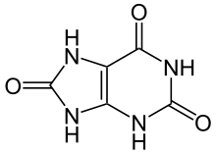

Hyperuricemia: high uric acid aka urate
Uric Acid > 7 mg/dL
Goal < 6 mg/dL
Uric acid is excreted renally (has no function).
Cause of Hyperuricemia (CAN’T LEAP)
Cyclosporine
Alcohol
Niacin: Vitamin B3
Thiazide
Levodopa
Ethambutol (TB)
Aspirin
Purine foods, Pyrazinamide (TB)
Uric Acid
URIC !!!

Slide 2
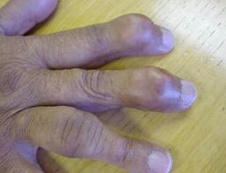

Tx of Hyperuricemia
Goal Uric Acid < 6 mg/dL
Don’t start Allopurinol during ACUTE attack
Who to Tx:
Pts with S/S (gout attacks)
Pts with tophi
Pts with nephrolithiasis (stones)
Pts with nephropathy
tophi
Al-lot of
Pure water
 | Allopurinol | Probenecid
MOA | Next slide | Inhibits uric acid reabsorption
Dose | Start 100 mg daily Most will need 300 mg daily If CKD 50 mg daily Metabolite Oxypurinol → bone marrow suppression + 10 glasses of water | 250 mg BID + 10 glasses
Titrate | Q2-5 weeks | Q1-2 weeks
Screening | HLA-B*5801 | CI if ClCr < 50
Monitor | Steven John’s Syndrome SCr Uric Acid | Uric Acid
D-D | Next slide | Penicillin (good)
Notes:
Know dosing
Probenecid inhibits renal reabsorption. That’s why it’s Contraindicated if pt has renal issues

Slide 3
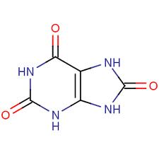
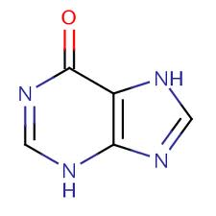
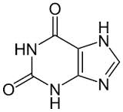
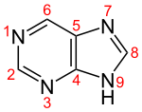
Allopurinol MOA
Inhibits Xanthine Oxidase
Allopurinol
-
-
Xanthine
Oxidase
Xanthine
Oxidase
Excretion
Purine
Hypoxanthine
Xanthine
uric acid
D-D with Allopurinol | Tx | Reason | Avoid by
Azathioprine | Prodrug of 6-MP | Same as 6-MP
Mercaptopurine (6-MP) | Immunosuppressive | Inhibits metabolism | 50% allopurinol
Methotrexate
Al hydroxide | Antacid | Decrease absorption | Take allopurinol 3 hr before or 6 hr after
ACE-Inhibitors | BP | Allopurinol hypersensitivity
Cyclophosphamide | cancer | Increases cyclo
Theophylline | COPD | Xanthene oxidase inhibitor
Notes:
D-D Allopurinol + Azathioprine
Oxypurinol can be a bone marrow depressant

Slide 4
Drug-Drug Interactions with Allopurinol
Allopurinol
6-MMP
(inactive)
Xanthine oxidase
Azathioprine
6-mercaptopurine
6-thiouracil
(inactive)
Bone marrow suppression
↓ Azathioprine/ 6-MP dose by 50% when allopurinol is added

Slide 5
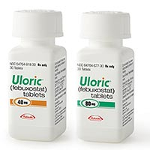
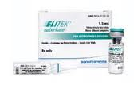
Febuxostat (Uloric)
Indication: Hyperuricemia
Pros:
Use in patients with renal insufficiency → elim hepatic
Use if pt is allergic to allopurinol
Dose: 40 mg daily
Rasburicase (Elitek)
Indication: Hyperuricemia
Pros Effective
Cons: Blood
Hemolytic Anemia
Conta in G6PD deficiency
Methemoglobinemia
Notes:
Know dosing

